Slide 1
MACHINE LEARNING
Project Title: Customer Subscription Prediction
Submitted By: SHREYANK PUROHIT
LinkedIn Id : shreyankpurohit13
Github Id : Shreyank1397

Slide 2
Information about Dataset
There are 45211 rows and 17 columns.
No null values in any column.
Data type for columns is object(10 columns) and int64(10 columns).
Will build classification models on this dataset.

Slide 3
OBJECTIVES
Perform basic EDA
Data Cleaning
Z-score test for treating outliers
Clean the data with formatting issues if any. (converting data types, replacing dollars, etc.)
Build a classification model first and calculate Confusion Matrix, AUC, F1 Score, Precision, Recall and Accuracy.
Build at least a minimum of 4 different models. All the models should use K-Fold cross Validation to train the model with at least 5-fold cross validation.
Run hyperparameter tuning on all the models and pick the best parameters (A minimum of 2 Parameters should be tuned) and picked.
Now, compare the models and pick the ideal one.

Slide 4
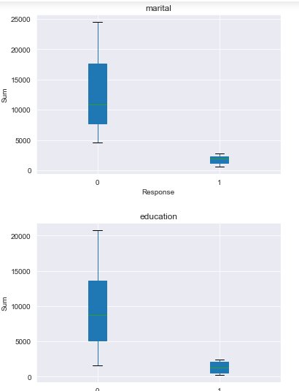
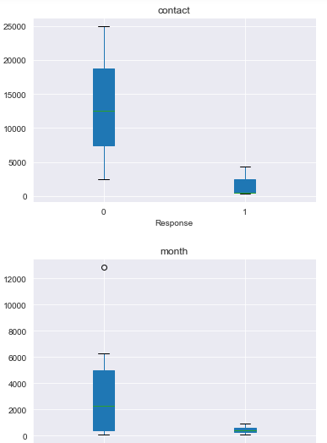
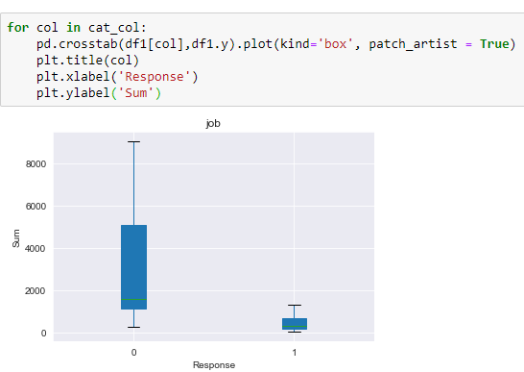
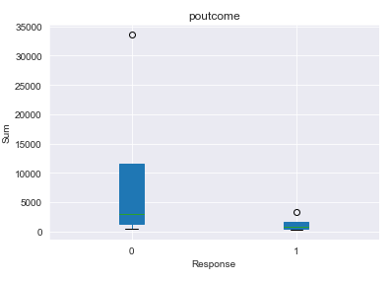
EDA
Plotting box plots for the sum of categorical values and with respect to target.

Slide 5
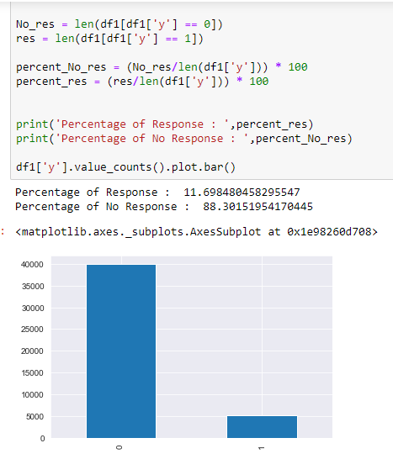
EDA
Distribution of target variable.
Percentage for response is 11.69%
Percentage for no as response is 88.30%

Slide 6
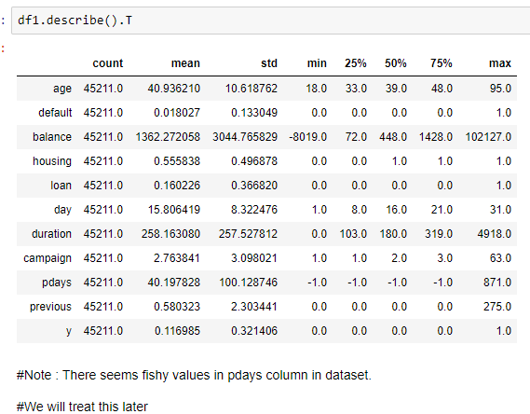
EDA
Aggregation of numerical columns.
Note : There are some fishy values in pdays column of dataset.

Slide 7
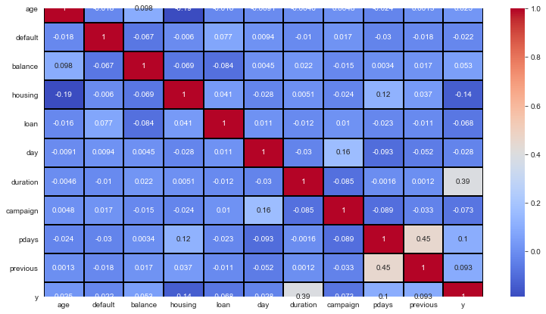
EDA
Checking Correlation using heat map.

Slide 8
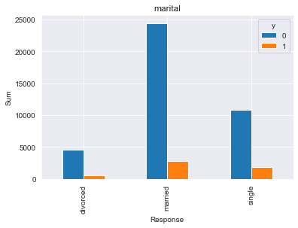
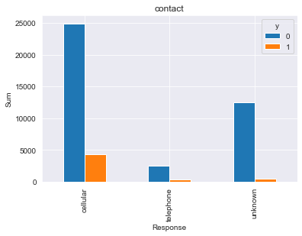
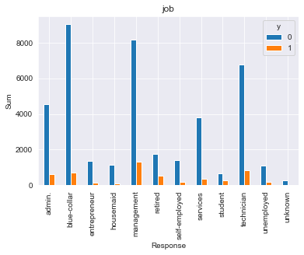
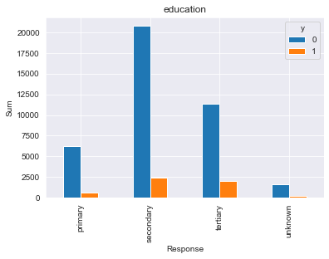
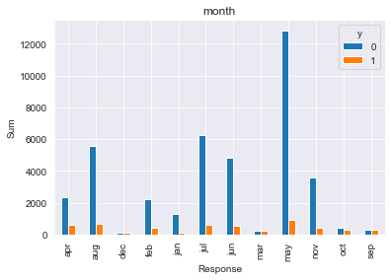
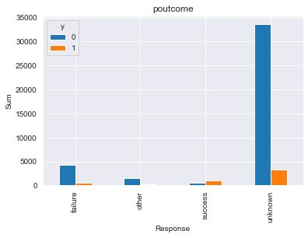
EDA
Plotting bar plots for the sum of categorical values and with respect to target.

Slide 9
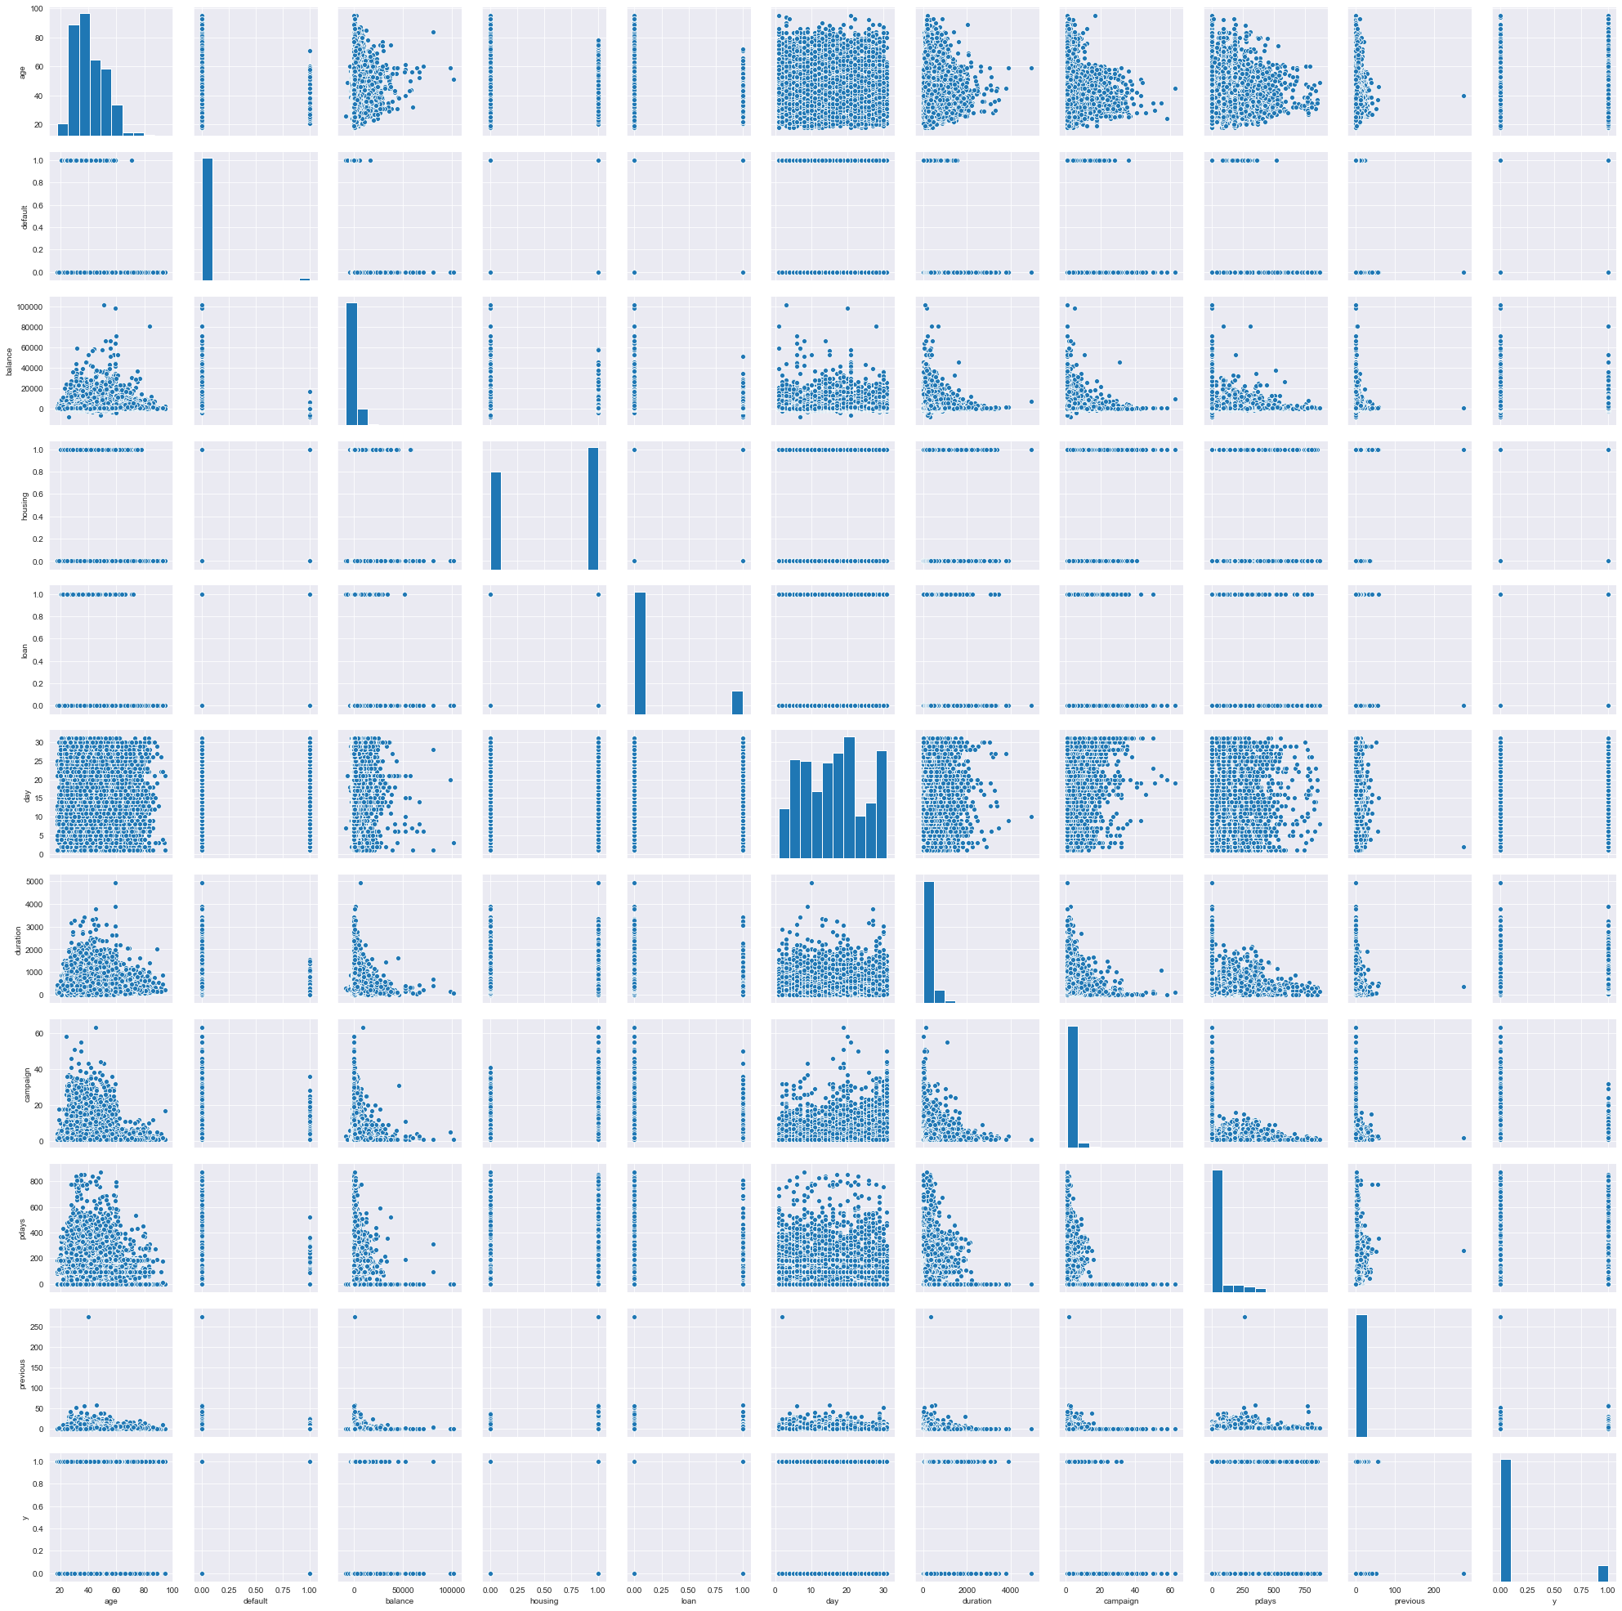
EDA
Pair-Plot

Slide 10
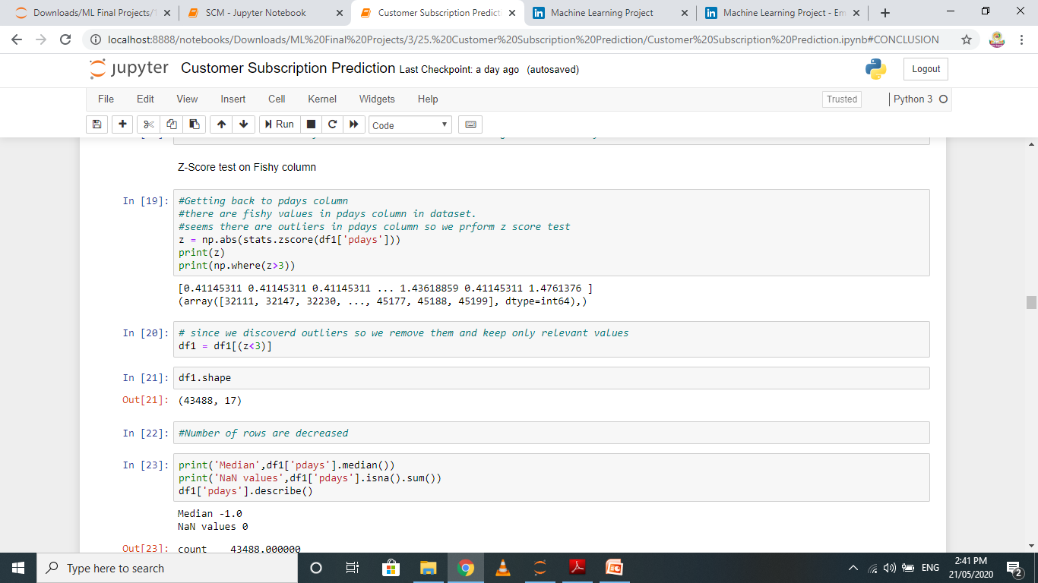
Z-Score Test
Performing z-score test on pdays column.
The shape of data is changed.
Number of rows are now 43488.

Slide 11
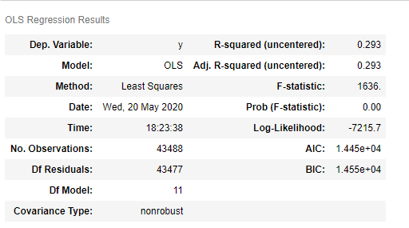
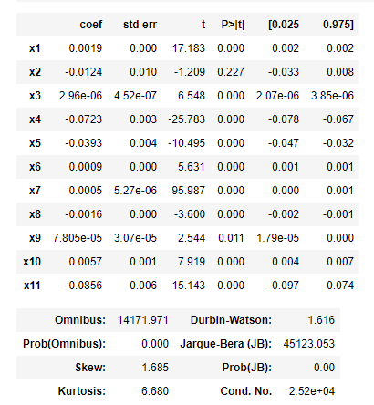
P-Value Test
Performing P-value test.
P-value test does not favor default and old pdays columns so we drop them.

Slide 12
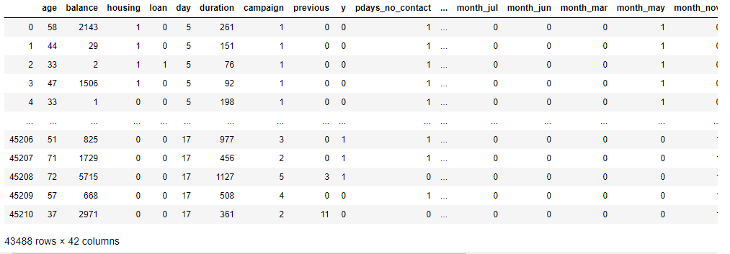
Encoding of columns
Encoding categorical columns using get_dummies.
The Shape has changed, number of columns are now 42.

Slide 13
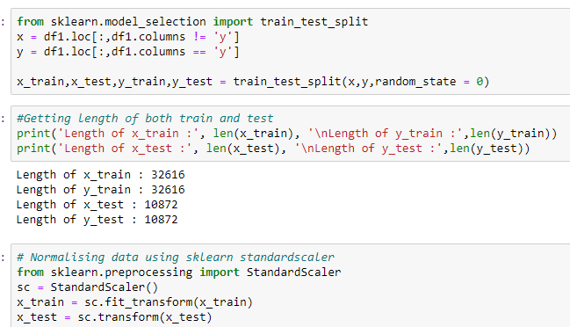
Train-Test Split
Length of the train and test data is given in image.

Slide 14
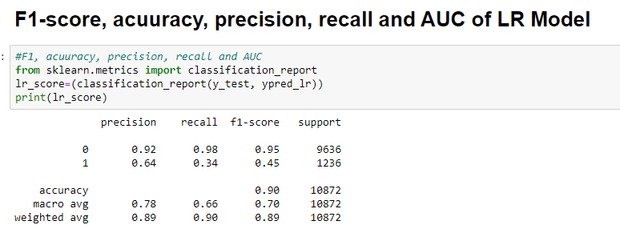
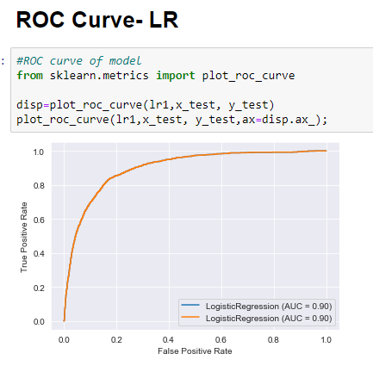
Logistic Regression Model
Tunned Model using hyperparameter tuning.

Slide 15
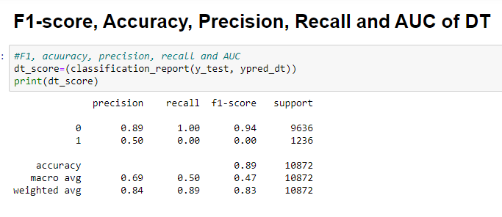
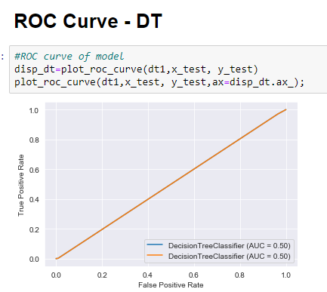
Decision Tree Model
Tunned Model using hyperparameter tuning.

Slide 16
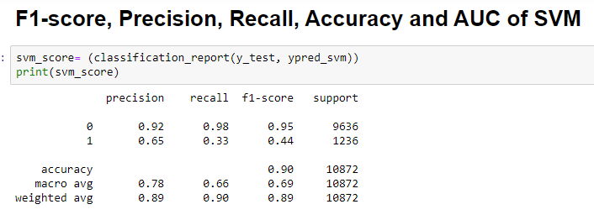
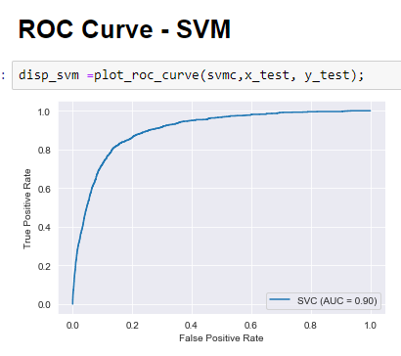
SVM Model
Tunned Model using hyperparameter tuning.

Slide 17
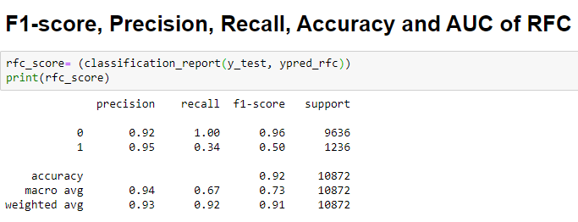
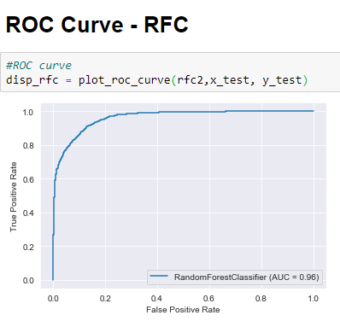
Random Forest Classifier Model
Tunned Model using hyperparameter tuning.

Slide 18
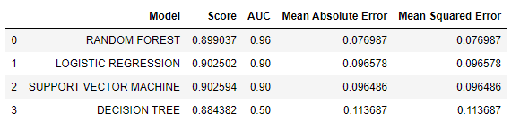
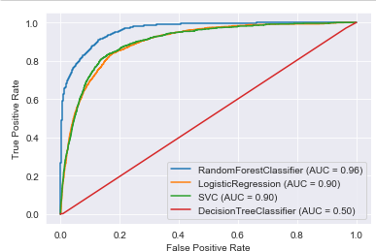
Comparing Models
Comparing using ROC Curves and DataFrame

Slide 19
Conclusion
We observed that Random Forest Classifier has the highest AUC among all and minimum MAE and MSE value.
Hence, we select Random Forest Classifier as the best model suited for this Dataset.

Slide 20


